Slide 1
Collaboration at the CSCLV
Carolyn Yucha, RN, PhD, FAAN
University of Nevada Las Vegas

Slide 2
CSCLV
Collaborative venture among UNLV & NSC Schools of Nursing & UN School of Medicine
Multi-disciplinary & multi-institutional
31,000 square feet
Serving educational needs of 500 nursing students & 100 medical students & residents each year.

Slide 3
Nevada

Slide 4
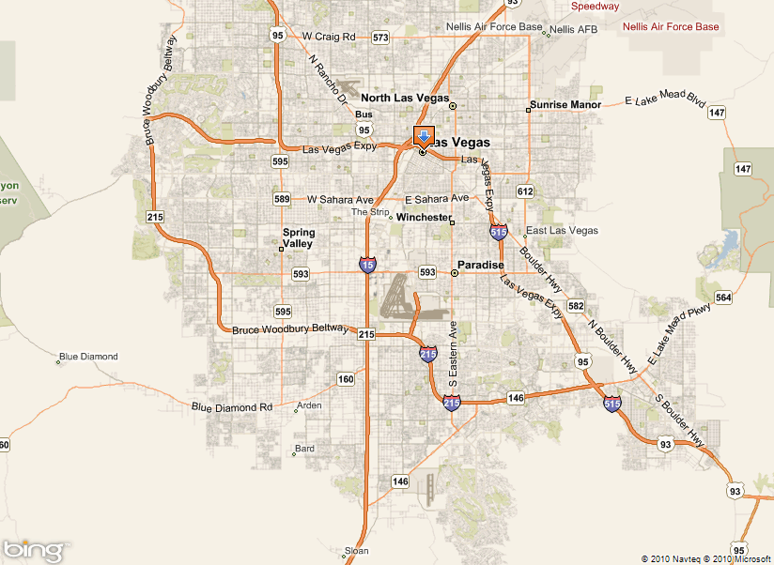
Las Vegas
X
X
X

Slide 5
CSCLV
UNLV SON
NSC SON
CSCLV
UN SOM

Slide 6
Decisions
? Money ?
? Space ?
? Staff ?
? Power ?
? Control ?

Slide 7
Questions
Where? Space
Who? Staff
When? Schedule
How? Money
What? Strategic Plan

Slide 8
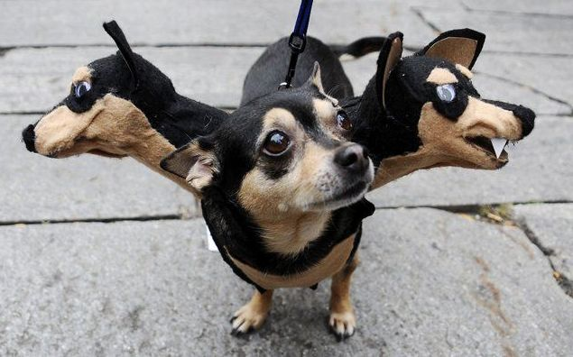
Cooperation
To move forward in one direction

Slide 9
Questions
Where? Space

Slide 10
Space
Who gets what?
Which space is mine?
I need more space
That’s not enough space!
I’m special – I need more
MORE MORE MORE
Notes:
Every Wednesday for about 6 months
Architects – very helpful in keeping peace.
Process based on data

Slide 11
Politeness is the poison of collaboration.
Edwin Land
Notes:
American Inventor
Polaroid filter – used for film & sunglasses
Polaroid camera
What was Land like? Knowing him was a unique experience. He was a true visionary; he saw things differently from other people, which is what led him to the idea of instant photography. He was a brilliant, driven man who did not spare himself and who enjoyed working with equally driven people

Slide 12
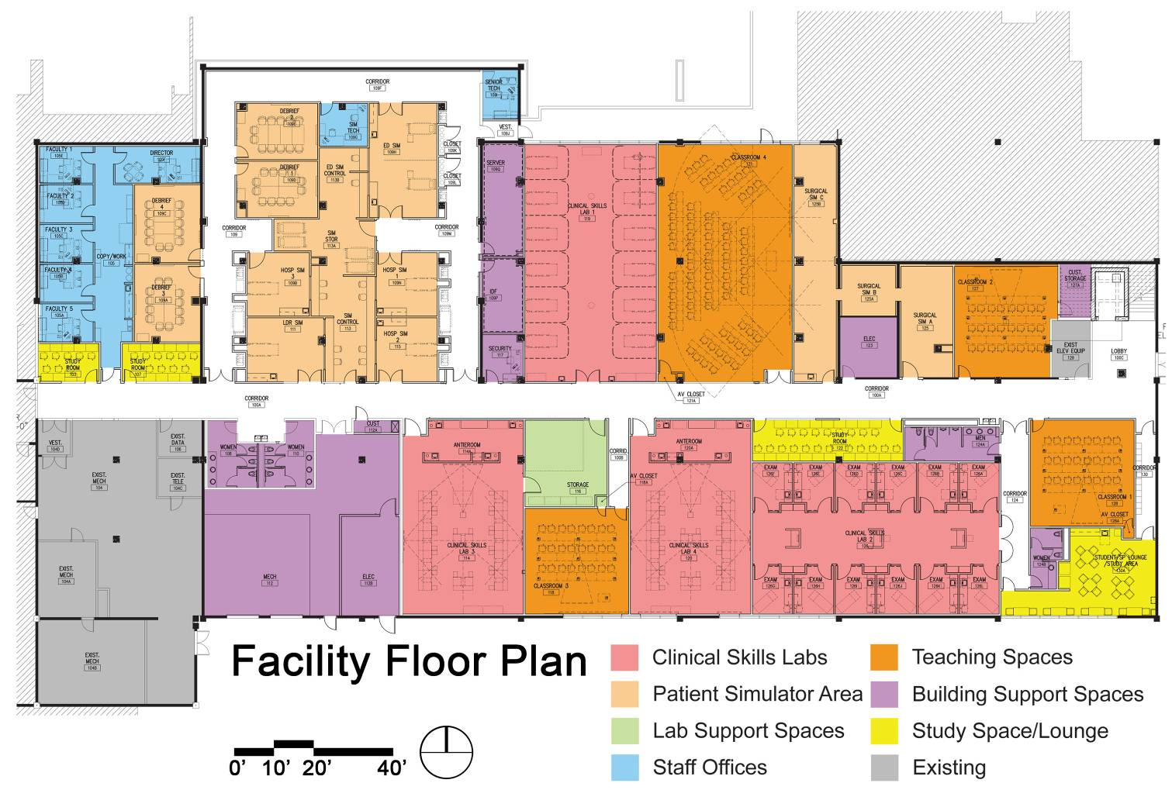
Floor Plan
Space Plan by Usage Type
Notes:
12

Slide 13
Questions
Who? Staff

Slide 14
Staffing
What staff do we need?
Who works for me?
Who will employ the staff?
Who will handle recruitment & EEO?
Who will they report to?

Slide 15
Unless both sides win,
no agreement can be permanent.
Jimmy Carter
We had 3 sides that needed to WIN.

Slide 16
Staff 2009
Director
Simulation Clinical Technician (2)
Clinical Skills Laboratory Assistant
Administrative Assistant

Slide 17
Center Administrator/Director
(Shared)
Clinical Skills Laboratory
Assistant (Shared)
Simulation Clinical
Technician (Shared)
Simulation Clinical
Technician (Shared)
MS Nurse
Educator
MS Nurse
Educator
(UNLV)
MS Nurse
Educator
MS Nurse
Educator
(NSC)
Surgical Simulation
Technician
(UNSOM)
Standardized Patient
Lab Manager/Skills
Support (UNSOM)
MS Nurse
Educator
(UNLV)
MS Nurse
Educator
(NSC)
Faculty Support
From General Faculty
(UNSOM)
Faculty Support
From General Faculty
(UNLV/NSC)
Existing staff to support Center, but remain in their current institutions.
Shared staff funded by student fees or institutional contributions.
UNLV Nursing staff reassigned to Center
NSC Nursing staff reassigned to Center
UNSOM staff reassigned to Center

Slide 18
Staff 2012
Operational Director
Educational Director
6 staff
Student Workers
Volunteers

Slide 19
Organization
Advisory Committee: Deans from UNLV, NSC, & UNSOM
Educational Director
Operational Director
Community
Faculty
Volunteers
Student Workers
Simulation Operations (Sim Ops) Committee
IT Systems Administrator
Simulation Training Coordinators
IT Technician
Notes:
Operational Director: Ms. Jackie Kinsey
The Operational Director provides supervisory, administrative, & operations services to the CSCLV & its users. Responsibilities include management of the budget, scheduling, personnel, & external events & ensuring that financial information is accurate & reliable, & the center complies with applicable laws, regulations, policies, & procedures.
Educational Director: TBA
The Educational Director serves as an overall educational leader of the CSCLV. The individual ensures that the three institutions use the center to optimize educational programming. This includes developing faculty & staff training programs, promoting inter-professional education, facilitating research projects, & strategic planning.
Advisory Committee:
This committee serves as the oversight body for the center. The committee meets bi-weekly to address educational & operational issues to meet the center’s needs.
IT Systems Administrator: Mr. Jonathan Sturak
The IT Systems Administrator Identifies, implements, manages & supports all IT, AV, teleconference, computerized human patient simulator, computerized training devices infrastructure, interfaces & operations.
The Simulation Training Coordinators:: Ms. Suzanne Sharp & Ms. Rowena Saba
The Clinical Support Coordinators have primary responsibility for immersive patient care management simulation scenario operations & clinical skills operations.
IT Technician: Mr. Richard Dantes
The IT Technician supports network operations as well as hardware, software, & A/V coordination & support. & serves as a backup for high fidelity simulation & skills training for all learners & external contracts..
Surgical Skills Coordinator: Mr. Adnan Mohsin
The Surgical Skills Coordinator is responsible for implementing & assisting instruction of surgical residents & third year medical students for the Department of Surgery.
Standardized Patient Coordinator: Ms. Gigi Guizado de Nathan
The Simulation Education Coordinator hires & trains standardized patients & coordinates all events using standardized patients.

Slide 20
Questions
When? Schedule

Slide 21
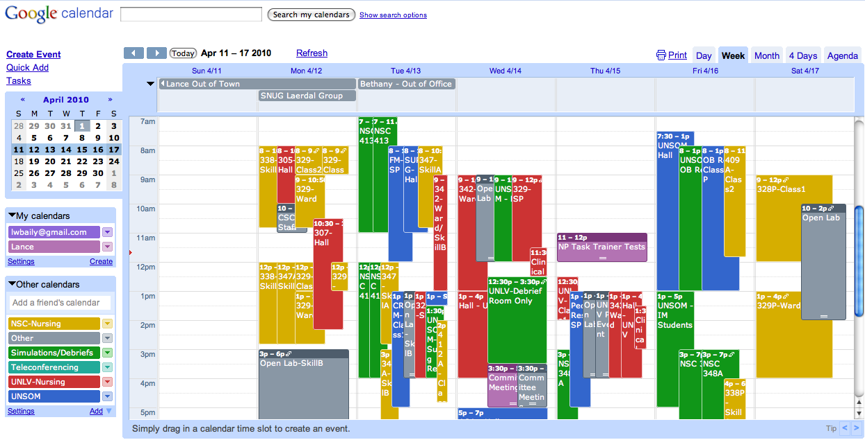
Schedule
Google Calendar: Free & Expandable

Slide 22
Conclusions
Make your project the priority of decision-makers.
It is easier to obtain funding for collaborative projects.
With persistence & creative thinking, it is possible to piece together sufficient funding, even in a recession.

Slide 23
Cooperation
Listen
Place yourself in others’ shoes
Listen
Agree to disagree
Listen
Everyone must get educational needs met
Laugh together, Celebrate together

Slide 24
Challenge
What? Strategic Plan
Educational Director
Faculty Training
Research
Interdisciplinary Education

Slide 26
CSCLV Funding Model
Carolyn Yucha, RN, PhD, FAAN
University of Nevada Las Vegas

Slide 27
Funding
How are we going to pay for this?
You should pay
We have no money

Slide 28
Principles
Significant funds were needed to develop the CSCLV. These were obtained over a number of years.
Student fees were based on estimated number of students & space usage: 40-40-20 split.

Slide 29
UNLV
NSC
CSCLV
UNSOM

Slide 30
UNLV
40%
NSC
40%
CSCLV
UNSOM
20%

Slide 31
Costs
Technical Staff, Equipment, Supplies
Paid by Student Fees
Director & Administrative Assistant
Paid by UNLV & UNSOM
Standardized Patient Program
Paid by UNSOM – reimbursed by UNLV

Slide 32
Agreements
Simulation Training is very expensive.
Space usage & costs: UNLV 40%, NSC 40%, UNSOM 20%.
Costs for technical support, equipment, supplies & software is covered by student fees.
Total costs is approximately $400,000.

Slide 33
More agreements
Nursing share is $320,000
Allocation to UNLV & NSC is based on number of students, not equally divided.
Cost to nursing students: $300 per course.
Cost to medical students: $600 per year.

Slide 34
Technical Staff, Equipment, Supplies
UNLV
40%
5 courses x $300
NSC
40%
4 courses x $300
CSCLV
UNSOM
20%
Annual fee $600

Slide 35
Even more agreements
Costs for Director & Administrative Assistant is paid by UNLV & UNSOM
New account was established for funds.
Dates were selected for transfer of funds to this account

Slide 36
Director & Administrative Assistant
UNLV
40%
5 courses x $300
NSC
40%
4 courses x $300
CSCLV
UNSOM
20%
Annual fee $600

Slide 37
Budget
Item | Source | Amount
Technical Staff | Student Fees | $290,000
Equipment, Supplies, Software | Student Fees | $110,000
Educational & Operational Directors | UNLV & UNSOM | $166,500
Total Operating Budget |  | $566,500
Standardized Patient Program | UNSOM, reimbursed by UNLV | $130,000

Slide 38
Standardized Patient Program
UNLV
40%
5 courses x $300
NSC
40%
4 courses x $300
CSCLV
UNSOM
20%
Annual fee $600

Slide 39
Funding
UNLV
40%
5 courses x $300
NSC
40%
4 courses x $300
CSCLV
UNSOM
20%
Annual fee $600

Slide 40
If necessity is the mother of invention, it's the father of cooperation & we're cooperating like never before.
John Ashcroft
Notes:
Governor of Missouri, US Senator, US Attorney General

Slide 41
Conclusion
Over the 3 years of operation, the CSCLV operations & budget have evolved to meet the changing needs of our students.
The basic agreements, established in good faith before the center opened, are still followed.

Slide 42
Cooperation
To move forward in one direction

Slide 43
Questions
Where? Space
Who? Staff
When? Schedule
How? Money
What? Strategic Plan

